Slide 1
Computer Input/output System
2019
Instructors: Yang Quansheng
School of Computer Science and Engineering
College of Software Engineering
Southeast University

Slide 2
Chapter 1:
The IA-32 Microprocessor

Slide 3
Outline
Computer Components
Intel X86 CPU
Real-address mode memory model
Data Type
Basic Program Execution Registers
Addressing Modes

Slide 4
1.1 Computer Components
At a top level, a computer consists of CPU, memory and I/O components, with one or more modules of each type.
Central processing unit(CPU)
Arithmetic-logic
unit(CA)
Main
Memory
(M)
I/O equip-ment
(I,Q)
Program
control
unit(CC)

Slide 5

1.1 Computer Components
Such a design is referred to as the von Neumann architecture and is based on three key concepts:
  Data and instruction are stored in a single read-write memory.
  The contents of this memory are addressable by location, without regard to the type of data contained there.
  Execution occurs in a sequential fashion
  (unless explicitly modified) from one
  instruction to the next.
von Neumann

Slide 6
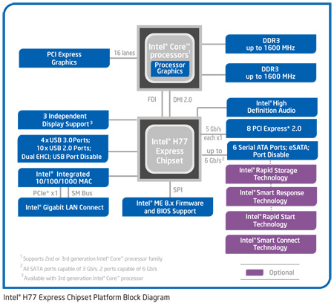
1.1 Computer Components
Microcomputer with Intel 7 Series Chipset
CPU
Memory
I/O
Platform Controller Hub(PCH)

Slide 7
1.2 Intel X86 CPU
IA-16 8086、8088、80286
Before Pentium 80386、80486
P5 Pentium、Pentium MMX
P6 Pentium Pro、Pentium II、Pentium III、Pentium M
IA-32
Pentium
X86
CPU
NetBurst Pentium 4
Core Core Duo
Pentium NetBurst Pentium D、Pentium Extreme Edition
Core Core 2 Duo、Core 2 Quad、 Core 2 Extreme
Intel 64
Nehalem Core i7、Core i5、Core i3
SandBridge Core i7/i5/i3 (2nd Generation)
Core i Series
Ivy Bridge Core i7/i5/i3 (3rd Generation)
Haswell Core i7/i5/i3 (4th Generation)
Broadwell Core i7/i5/i3 (5th Generation)
Skylake Core i7/i5/i3 (6th Generation)
Kaby Lake Core i7/i5/i3 (7th Generation)
Coffee Lake Core i7/i5/i3 (8th Generation)
Coffee Lake Refresh Core i9/i7/i5 (9th G)
Notes:
1978年推出了16位的Intel 8086，它的数据总线为16位，地址总线为20位，直接存储器的寻址达到1 MB（2²⁰）。
1979年Intel公司为了方便原来的8位机用户，推出了内部16位结构、外部数据总线为8位的Intel 8088，其指令系统和8086兼容。8086和8088都是属于IA-16结构（IA，Intel Architecture，Intel架构），它们为之后的IA-32结构奠定了基础，并为IA-32结构引入了段式存储管理的概念。8088没有浮点运算单元，而采用Intel 8087浮点协处理器协助浮点运算或用软件仿真。
1982年Intel公司研制出高档16位处理器80286，它的数据总线仍然是16位的，但地址总线增加到24位。80286具有两种工作模式：实地址模式和虚地址保护模式。实地址模式下，80286可以看做是一个高速的8086；虚地址保护模式下可寻址16 MB（2²⁴）物理地址和1 GB的虚拟地址空间，并提供段边界检查、只读和只执行段设置，以及4种特权级等保护机制。
1985年，Intel公司推出了第一个32位处理器80386，它与8086向下兼容。80386具有32位数据线和32位地址线，它将IA-32结构的通用寄存器扩展到了32位。80386有3种工作模式：实地址模式、虚地址保护模式和虚拟8086模式。80386还把页式虚拟存储管理技术和平板式存储模式引入到IA-32结构中。
1989年， Intel公司推出了更高性能的32位处理器80486。在80486中集成了一个80386 CPU、一个与80387兼容的浮点运算部件（FPU）和一个8 KB的高速缓冲存储器（Cache）。80486的整数处理部件采用了RISC结构，将译码和执行单元分解成5级流水，但80486的其他部分依然保持CISC结构。80486首次采用了时钟倍频技术，使内部部件可以以输入时钟的倍频运行，这种倍频技术在Intel后续的CPU研发中被经常使用。
1993年诞生了IA-32结构的Pentium处理器，具有64位数据线和32位地址线，内部数据通路甚至加宽到128～256位。Pentium共有2条5级整型流水线，形成超标量结构，两个整型流水线可以与浮点部件独立工作。Pentium采用了分支预测技术，处理器效率得到提高。
1996年，Intel公司推出了一款Pentium的改进型32位处理器，即Pentium MMX、，它增加了57条MMX（多媒体扩展指令集）指令，采用了SIMD（单指令流多数据流）技术，提高了对多媒体数据的处理能力。
1996年，Intel公司还推出了采用新的P6微结构的处理器Pentium Pro。它采用了三条指令流水线的超标量结构，并在超标量结构中实现了动态执行技术（微数据流分析、乱序执行、更优的分支预测和推测执行）。Pentium Pro将一个256 KB的L2 Cache（二级Cache）封装进芯片内，L2 Cache和处理器同频高速工作。
1997年5月，Intel公司发布了Pentium Ⅱ（奔腾2代）。与Pentium Pro相比，Pentium Ⅱ增加了MMX技术，能同时处理两条MMX指令。L1 Cache增加到了数据和指令Cache各16 KB，并配备了512 KB甚至1 MB的L2 Cache。在总线方面，Pentium Ⅱ采用了双独立总线结构，前端总线FSB负责对主存储器的访问，后端总线连接到L2 Cache上。
1999年2月Intel公司发布了Pentium Ⅲ（奔腾3代），Pentium Ⅲ处理器首次将流SIMD扩展（SSE）技术引入到IA-32结构中，依靠新加的128位单精度浮点寄存器组，Pentium Ⅲ增强了MMX技术在多媒体处理上的能力。Pentium Ⅲ处理器首次内置序列号，能唯一标识一个处理器。
2000年底，Intel公司推出了基于NetBurst微结构的32位处理器Pentium 4。Pentium 4采用超深流水技术，使用长达20～31级的分支预测/恢复流水线。
Pentium D处理器是Intel最早的基于x86指令集的双核处理器，它在一个处理器封装中集成了两个完整的基于NetBurst微结构的内核，两个核以同频运行。
Pentium Extreme Edition依然是基于NetBurst微结构的双核处理器，与Pentium D不同的是Pentium EE还支持超线程技术。
2006年，Intel发布了基于新的Core微结构的Core 2 Duo处理器—酷睿2。它借鉴了移动平台上的Pentium M核心技术，采用了低功耗双核设计，改进了译码和SIMD的执行。Core微结构下的Core 2 Duo处理器使用的宽动态执行技术、智能内存访问技术、高级智能缓存技术、高级数字多媒体增强技术、智能功效管理技术等，提高了性能和能效。
酷睿智能处理器：也称为酷睿i系列，是增加了睿频加速技术后的CPU，睿频加速技术使得cpu的主频可以在某一范围内根据处理数据需要自动调整主频。它是基于Nehalem架构的电源管理技术，通过分析当前CPU的负载情况，智能地完全关闭一些用不上的核心，把能源留给正在使用的核心，并使它们运行在更高的频率，进一步提升性能；相反，需要多个核心时，动态开启相应的核心，智能调整频率。这样，在不影响CPU的TDP情况下，能把核心工作频率调得更高。
2010年，基于Nehalem微结构的Intel Core i7处理器采用45nm工艺，原生的四核结构配以超线程技术。Core i7使用Intel睿频加速（Turbo Boost）技术在高能效与高性能间转换；专用的电源控制单元能降低活跃与空闲功耗；集成在处理器内的存储控制器支持双通道或者3通道的DDR3存储器；Intel的QuickPath连接提供到芯片组的点到点连接。该处理器还支持第二代Intel虚拟化技术。
2011年，Intel推出了以SandyBridge微结构为基础的2代Intel酷睿处理器，2代酷睿处理器结构上进行了调整，不仅集成了内存控制器、PCI Express端口，还集成了显示部分和图形处理器，基于2代酷睿处理器的微机系统不再需要北桥芯片，只需要一片平台控制器中心芯片与处理器搭档。
2012年，Intel又继续其制程的推进，推出了采用22nm工艺，Ivy Bridge微结构的3代Intel酷睿处理器。Ivy Bridge结合了22纳米与3D晶体管技术，在大幅度提高晶体管密度的同时，核芯显卡等部分性能甚至有了一倍以上的提升。
2013年，Intel推出称为第四代酷睿的Haswell微结构酷睿i系列处理器，Haswell在核心架构方面继承了Sandy Bridge与Ivy Bridge的设计思路，主要依旧采用了模块化设计，并且每个核心都有对应的三级缓存用来对应环形总线。在CPU核心架构中，Haswell增加了到了7个端口，每个时钟周期可同时进行八个操作。同时整数ALU与内存寻址也有了增强，各增加了一个端口。在指令集方面，Haswell最大的改进在于AVX2指令集，其浮点计算性能同样达到了翻番的水平，并且还支持了FMA3等新指令集。在AVX2指令集的辅助下，Haswell的内存带宽翻了一倍，并且TSX技术也让多核心处理效率大大提高。Haswell对内存存取带宽方面拥有了大幅提升，L1载入带宽从32Bytes/cysle增强到64Bytes/cycle，拥有了一倍的性能提升。同时L2的TLB也拥有了非常大的提升，这对于大规模数据读取来说拥有绝佳的性能表现。“Haswell”的特性可以总结为以下四点：1、22nm工艺新架构，性能更强，超频潜力更大，而且集成了完整的电压调节器；2、新的指令集，Haswell添加了新的AVX指令集，改善AES-NI的性能；3、核芯显卡增强，支持DX11.1、OpenCL1.2，优化3D性能，支持HDMI、DP、DVI、VGA接口标准；4、接口改变，使用LGA1150接口，不兼容旧平台。由于Haswell中整合了完整的电压调节器，使得下一代主板的供电设计变得更加简单。
2015年1月和5月Intel推出称为第五代酷睿的Broadwell 微结构酷睿i系列处理器，主要是Haswell微架构下工艺达到14nm，芯片面积缩小，功耗进一步下降，并支持3D实感技术。但这可能是最短命的一代酷睿
2015年8月，Intel公布了第六代酷睿，采用 Skylake微架构，提升了续航能力，实感技术，并专门针对Win10优化了响应速度，支持DDR4，引入了一项名为“Speed Shift”的电源管理技术，它主要改进了系统的突发响应时间。Speed Shift技术让处理器能够直接与电源控制单元沟通，并将所有电源状态都开放给操作系统，三者配合之下，SpeedShift平台最快可以在1毫秒的时间内完成状态切换（以前的SpeedStep技术需要30毫秒）。
2016年8月，Intel公布了第七代酷睿，采用 Kaby Lake微架构，依然是14nm工艺，但Kaby Lake的晶体管性能比前代产品提升了将近12%，这给它带来了更出色的能效表现。第六代Core的睿频切换延迟需要接近100毫秒，而现在Kaby Lake平台也对此作出改进，新一代SpeedShift技术可以让睿频状态的加速延迟降低到5毫秒。Kaby Lake在视频性能方面获得大幅度的增强，Intel为它加入了增强的视频引擎，它包括MFX（Multi-Format Codex ，多媒体解码器）和VQE（Video Quality Engine ，视频质量引擎）两个部分。

Slide 8
Summary
Part Number | Bits | Address Bus Width | Data Bus Width
8086/8088* | 16 | 20 | 16/8
80286 | 16 | 24 | 16
80386 | 32 | 32 | 32
80486 | 32 | 32 | 32
Pentium | 32 | 32 | 64
PentiumIII | 32 | 36 | 64
Pentium 4 | 32 | 36 | 64
PentiumD | 64 | 36/40 | 64
Core2 Duo | 64 | 36/40 | 64
Core 2 Quad | 64 | 36/40 | 64
Nehalem | 64 | 36/40 | 64
Sandy Bridge | 64 | 36/40 | 64
* We will introduce it in chapter 3
Notes:
列出即可，不细讲

Slide 9
1.2 Intel X86 CPU
8088/8086 Block Diagram
Address BUS
20-bit
General-purpose Registers
AH AL
AX
BH BL
BX
∑
CH CL
CX
Data bus
8088:8-bit 8086:16-bit
DH DL
DX
CS
SP
DS
Segment
Register
BP
SS
DI
ES
Bus Control Logic
SI
Instruction Pointer
IP
Extr.
BUS
ALU data bus（16bits）
Internal Register
Computing Register
Q Bus
（8bit）
Instruction queue
EU control System
1 2 3 4 5 6
ALU
8088
Execute Unit(EU)
Bus Interface Unit (BIU)
8086
Flag register

Slide 10
1.2 Intel X86 CPU
Mode of Operation
  Real-address mode
    In 8086/8088, this is the only mode.
    In 80286 or above, this mode implements the programming environment of the Intel 8086 processor with extensions (such as the ability to switch to protected or system management mode).
    The processor is placed in real-address mode following power-up or a reset.
    Allow microprocessor to address only the first 1M byte of memory space

Slide 11
1.2 Intel X86 CPU
Mode of Operation
  Protected mode (80286 or above)
    This mode is the native state of the processor.
    Support multi-tasking operations, and to protect the data and procedures for each task
    This mode allows applications to access physical memory greater than 4 GByte using PAE (Physical Address Extensions, 80386 or above).
    Virtual address space=64TB (2⁴⁶)
    Protected mode is where Windows operates.

Slide 12
1.2 Intel X86 CPU
Mode of Operation
  Virtual-8086 mode (IA-32 or above)
    Among the capabilities of protected mode is the ability to directly execute “real-address mode” 8086 software in a protected, multi-tasking environment.
    This feature is called virtual-8086 mode, although it is not actually a processor mode. Virtual-8086 mode is actually a protected mode attribute that can be enabled for any task.

Slide 13
1.2 Intel X86 CPU
Mode of Operation
  System management mode (SMM) (IA-32 or above)
    This mode provides an operating system or executive with a transparent mechanism for implementing platform specific functions such as power management and system security.
    In SMM, the processor switches to a separate address space while saving the basic context of the currently running program or task. SMM-specific code may then be executed transparently.
    Upon returning from SMM, the processor is placed back into its state prior to the system management interrupt.

Slide 14
1.2 Intel X86 CPU
Mode of Operation
  IA-32e mode (Intel64 or above)
    Compatibility mode (sub-mode of IA-32e mode)
      Compatibility mode permits most legacy 16-bit and 32-bit applications to run without re-compilation under a 64-bit operating system.
      Legacy applications that run in Virtual 8086 mode or use hardware task management will not work in this mode.
      Applications access only the first 4 GByte of linear-address space. Compatibility mode uses 16-bit and 32-bit address and operand sizes.

Slide 15
1.2 Intel X86 CPU
Mode of Operation
  IA-32e mode (Intel64 or above)
    64-bit mode (sub-mode of IA-32e mode)
      This mode enables a 64-bit operating system to run applications written to access 64-bit linear address space.
      64-bit mode extends the number of general purpose registers and SIMD extension registers from 8 to 16.
      General purpose registers are widened to 64 bits. The mode also introduces a new opcode prefix (REX) to access the register extensions.

Slide 16
1.3 Real-address mode memory model
Fundamental
  The memory cell is addressing by byte.
  A multi-byte object is stored as a contiguous sequence of bytes, with the address of the object given by the smallest address of the bytes used.
  For ordering the bytes representing an object, there are two common conventions.
    little endian: where the least significant byte comes first, it store at the smallest address.
    Big endian: where the most significant byte comes first, it store at the smallest address.
  X86 CPU use little endian.

Slide 17
1.3 Real-address mode memory model
By little endian:
12H
34H
56H
78H
9AH
BCH
DEH
FFH
0000H
0001H
0002H
0003H
0004H
0005H
0006H
0007H
At address 0000H:
a Byte is
12H
a Word is
3412H
a Doubleword is
78563412H
a Quadword is
FFDEBC9A78563412H

Slide 18
1.3 Real-address mode memory model
  Alignment of Words, Doublewords, and Quadwords
    If a number consists of K bytes (K is the Nth power of 2), the lower N = log₂K bits of its address are all 0s and this number is aligned.
    The natural boundaries for words, double words, and quadwords are even-numbered addresses, addresses evenly divisible by four, and addresses evenly divisible by eight, respectively.
3 2 1 0 3 2 1 0
4 8 12
4 8 12
Aligned No Aligned
Notes:
解释数据的对齐与不对齐存放下访问的不同

Slide 19
1.3 Real-address mode memory model
  Alignment of Words, Doublewords, and Quadwords
    To improve the performance of programs, data structures (especially stacks) should be aligned on natural boundaries whenever possible.
    The reason for this is that the processor requires two memory accesses to make an unaligned memory access; aligned accesses require only one memory access.
3 2 1 0 3 2 1 0
4 8 12
4 8 12
Aligned No Aligned
Notes:
解释数据的对齐与不对齐存放下访问的不同

Slide 20
1.3 Real-address mode memory model
Real mode memory addressing
  All real mode physical memory address are 20 bits wide.
  All real mode logical memory addresses must consist of a segment address plus an offset address.
    Segment(duan) address(16 bits): located within one of segment register, defines the beginning address of any 64K-byte memory segment.
    Offset(pianyi) address(16 bits): selects any location within the 64K-byte memory segment.
    Writing as Segment address : Offset address
Notes:
这里补讲一下是地址模式的存储，16位寄存器解决20位地址的问题

Slide 21

1.3 Real-address mode memory model
physical address and Logic address
physical address =
segment address ×10H(16) + offset address
16bits segment address
:
16bits offset address
（4-bits shift left）
16bits segment address
0000
+
16bits offset address
=
20bits physical address
6417H∶0100H
6417H×10H + 0100H = 64170H + 0100H = 64270H

Slide 22
1.3 Real-address mode memory model
The real mode memory-addressing scheme
  Using a segment address plus an offset.
00000H
10000H
1F000H
1FFFFH
FFFFFH
64k-byte segment
Segment register
1000H
Effective Address
Offset = F000H
≈
≈

Slide 23
1.4 Data Type
Numeric Data Types
  Integer
    Unsigned Integers
      Unsigned integers are unsigned binary numbers contained in a byte, word, doubleword, and quadword.
      Unsigned integers are sometimes referred to as ordinals.
    Signed Integers
      Signed integers are signed binary numbers held in a byte, word, doubleword, or quadword.
      All operations on signed integers assume a two's complement representation.
Notes:
two‘s complement 二进制补码

Slide 24
1.4 Data Type
Numeric Data Types
    Signed Integers
      The sign bit is located in most significant bit(MSb).
Class |  | Two’s Complement Encoding
 |  | Sign
Positive | Largest … Smallest | 0 … 0 | 11…11 … 00…01
Zero |  | 0 | 00…00
Negative | Largest … Smallest | 1 … 1 | 11…11 … 00…00

Slide 25
1.4 Data Type
Numeric Data Types
  Integer
Data Types | bits | Value Range
 |  | Unsigned Integers | Signed Integers
bytes | 8 | 0～255 | -128~+127
words | 16 | 0～65535 | -32768~+32767
doublewords | 32 | 0～2³²-1(4G-1) | -2³¹~+2³¹-1
quadwords | 64 | 0～2⁶⁴-1(16T-1) | -2⁶³~+2⁶³-1

Slide 26
1.4 Data Type
Numeric Data Types
  Floating-Point Data Types
    The IA-32 architecture defines and operates on three floating-point data types:
      single-precision floating-point
      double-precision floating-point
      double-extended precision floating-point(c中并没有，高级语言不支持)
    The data formats for these data types correspond directly to formats specified in the IEEE Standard 754 for Binary Floating-Point Arithmetic.

Slide 27
1.4 Data Type
Numeric Data Types
  Floating-Point Data Types
Data Type | Sign | Biased Exponent | Mantissa | Approximate Normalized Range
single-precision | 1 | 8 | 24 | 1.18×10⁻³⁸ ~ 3.40 ×10³⁸
Double Precision | 1 | 11 | 53 | 2.23×10⁻³⁰⁸~ 1.79×10³⁰⁸
Double Extended Precision | 1 | 16 | 64 | 3.37×10⁻ ⁴⁹³²~ 1.18×10⁴⁹³²
Mantissa contains an implied(hidden) one-bit, the hidden bit is the first bit of the normalized real number.
Notes:
Mantissa contains an implied(hidden) one-bit，the hidden bit is the first bit of the normalized real number.
When normalizing a number, it is adjusted so that its value is at least 1, but less than 2. For example, if 12 is converted to binary(1100),it is normalized and the result is 1.1x2^3,the 1. is the hidden one-bit.

Slide 28
1.4 Data Type
Pointer Data Types
  Pointers are addresses of locations in memory
  In non-64-bit modes, the architecture defines two types of pointers: a near pointer and a far pointer.
  In 16-bit mode
    A near pointer is a 16-bit offset (also called an effective address) within a segment.
    A far pointer is a logical address, consisting of a 16-bit segment base address and a 16-bit offset.
  In 32-bit mode
    A near pointer is a 32-bit offset (also called an effective address) within a segment.
    A far pointer is a logical address, consisting of a 16-bit segment selector and a 32-bit offset.

Slide 29
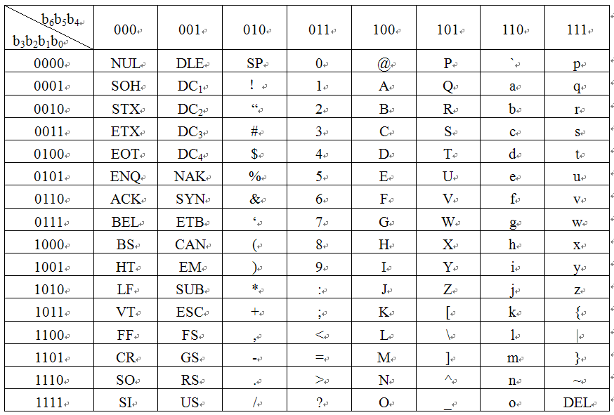
1.4 Data Type
ASCII Code Character
Notes:
LF=Line Feed 换行换到下一行同一列位置\r 0AH
CR=Carriage Return 回车回到本行行首\n 0DH SP 空格，第一个能打印的 20H
回车换行是两个操作

Slide 30
1.5 Basic Program Execution Registers
16 basic program execution registers for user in general system and application programming.
These registers can be grouped as follows:
  General-purpose registers
  Segment registers
  (E)FLAGS (program status and control) register
  (E)IP (instruction pointer) register.

Slide 31
1.5 Basic Program Execution Registers
General-Purpose Registers
  Operands for logical and arithmetic operations
  Operands for address calculations
  Memory pointers
16-bits
32-bits
AH AL
BH BL
CH CL
DH DL
SP
BP
DI
SI
AX
BX
CX
DX
SP
BP
DI
SI
EAX
EBX
ECX
EDX
ESP
EBP
EDI
ESI
Higher 16 bits
16bits
32bits
Notes:
64-bits： R开头

Slide 32
1.5 Basic Program Execution Registers
    EAX — Accumulator for operands and results data
    EBX — Pointer to data in the DS segment (Base Register)
    ECX — Counter for string and loop operations
    EDX — I/O pointer
      The lower 16 bits of these 4 registers map directly to the register set and can be referenced with the names AX, BX, CX, and DX.
      Each of the lower two bytes of these 4 registers can be referenced by the names AH, BH, CH, and DH (high bytes) and AL, BL, CL, and DL (low bytes).
Notes:
IO地址放在DX里或者EDX；

Slide 33
1.5 Basic Program Execution Registers
    ESI — Pointer to data in the segment pointed to by the DS register; source pointer for string operations (Index Register)
    EDI — Pointer to data (or destination) in the segment pointed to by the ES register; destination pointer for string operations (Index Register)
    ESP — Stack pointer (in the SS segment)
    EBP — Pointer to data on the stack (in the SS segment) (Base Register)
      The lower 16 bits of these 4 registers map directly to the register set and can be referenced with the names SI, DI, SP, and BP.

Slide 34
1.5 Basic Program Execution Registers
Segment Registers
  The segment registers hold 16-bit segment selectors. A segment selector is a special pointer that identifies a segment in memory.
    CS - point to the code segment
    SS - point to the stack segment
    DS - point to the data segment
    ES - point to the data segment（附加数据段）
    FS, GS - point to the data segment
      FS and GS not uses in 16 bits
      assembler
Stack Segment
Data segment
Data segment
Code segment
……
a program
Notes:
代码段必须有

Slide 35
1.5 Basic Program Execution Registers
Default segment and offset combinations
Special Purpose | Segment | 16-bit Offset | 32-bit Offset
Instruction address | CS | IP | EIP
Data address | DS | BX、SI、 DI、an 8- or 16-bit number | EAX、EBX、ECX、EDX、 ESI、 EDI、an 8- or 32-bit number
Stack address | SS | SP or BP | ESP or EBP
String destination address | ES | DI | EDI for string instructions
General address | FS GS | - - | No default No default
Notes:
偏移在指令指针寄存器（PC）

Slide 36
1.5 Basic Program Execution Registers
Instruction Pointer Register
  The instruction pointer ((E)IP) register contains the offset in the current code segment for the next instruction to be executed.
  The EIP register cannot be accessed directly by software; it is controlled implicitly by control-transfer instructions (such as JMP, Jcc, CALL, and RET), interrupts, and exceptions.
Higher 16-bits
16-bits IP
32-bits EIP
Notes:
IP不能被指令直接修改，只有跳转指令才能修改IP；

Slide 37
1.5 Basic Program Execution Registers
EFLAG Register
  The 32-bit (E)FLAGS register contains a group of status flags, a control flag, and a group of system flags.
  Some of the flags in the EFLAGS register can be modified directly, using special purpose instructions.
  There are no instructions that allow the whole register to be examined or modified directly.

Slide 38
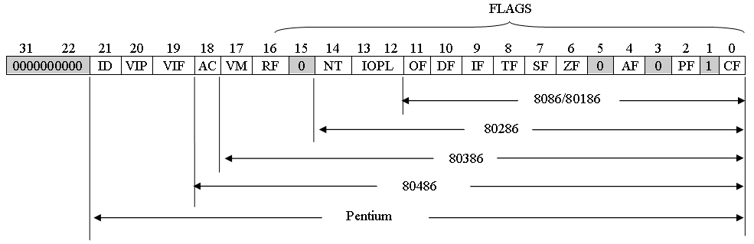
1.5 Basic Program Execution Registers
EFLAG Register

Slide 39
1.5 Basic Program Execution Registers
    The low 12 bits of EFLAG
b₁₅ b₈ b₇ b₀
OF DF IF TF SF ZF AF PF CF
CF | Carry flag 进位位（无符号数） | Set if an arithmetic operation generates a carry or a borrow out of the most-significant bit of the result; cleared otherwise.
PF | Parity flag （奇偶） | Set if the least-significant byte of the result contains an even number of 1 bits; cleared otherwise.（低八位奇数个1为0）
AF | Adjust flag | Set if an arithmetic operation generates a carry or a borrow out of bit 3 of the result; cleared otherwise.从结果的第3位产生进位或借位
ZF | Zero flag | Set if the result is zero; cleared otherwise.

Slide 40
1.5 Basic Program Execution Registers
    The low 12 bits of EFLAG
b₁₅ b₈ b₇ b₀
OF DF IF TF SF ZF AF PF CF
SF | Sign flag （符号位） | Set equal to the most-significant bit of the result, which is the sign bit of a signed integer.（永远和运算结果最高为保持一致）
TF | Trap flag （跟踪调试） | Set to enable single-step mode for（单步跟踪debugging; clear to disable single-step mode.
IF | Interrupt enable flag （可屏蔽中断） | Set to respond to maskable interrupts; cleared to inhibit maskable interrupts.

Slide 41
1.5 Basic Program Execution Registers
    The low 12 bits of EFLAG
b₁₅ b₈ b₇ b₀
OF DF IF TF SF ZF AF PF CF
DF | direction 串操作的方向 | Setting the DF flag causes the string instructions to auto-decrement. Clearing the DF flag causes the string instructions to auto-increment.
OF | Overflow flag（溢出标志） | Set if the integer result is too large a positive number or too small a negative number (excluding the sign-bit) to fit in the destination operand; cleared otherwise.
Notes:
次高位和最高位都进位或都不进位为0，否则为1；

Slide 42
1.5 Basic Program Execution Registers
Note
  Carry flag indicates an overflow condition for unsigned-integer arithmetic. It is also used in multiple-precision arithmetic.
  Overflow flag indicates an overflow condition for signed-integer (two’s complement) arithmetic.
  Adjust flag is used in binary-coded decimal (BCD) arithmetic.

Slide 43
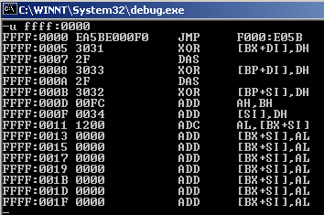
1.5 Basic Program Execution Registers
Note
  When the PC is reset, CS=FFFFH，EIP, DS, ES, SS, FS and GS=0, EFLAGS=2. So, when restarted, the address of the first instruction is (CS:EIP)FFFF:00000000.

Slide 44

1.6 Addressing Modes
Components of statement in assembly language
Addressing Mode is the way to find the operand in each instruction:
  Operand Addressing Modes
    We use MOV instruction introduce addressing mode.
  Programming Memory Addressing Modes
  Stack Memory Addressing Modes
[name:] mnemonic [[dest][,src]][;comment]
[ ] = optional;
dest and src are Operand
MOV dest , src ; src → dest

Slide 45
1.6 Addressing Modes
Operand Addressing
  IA-32 machine-instructions act on zero or more operands. Some operands are specified explicitly and others are implicit.
  The data for a source operand can be located in:
    the instruction itself (an immediate operand)
    a register
    a memory location
    an I/O port
  for a destination operand, it can be returned to:
    a register
    a memory location
    an I/O port

Slide 46

1.6.1 Operand Addressing Modes
Immediate Addressing
  Some instructions use data encoded in the instruction itself as a source operand.
CODE
CODE
LSB
OP
Opcode
OP
Opcode
D₇~D₀
8-bit operand
D₇~D₀
MSB
16-bit operand
D₁₅~D₈
Examples:
MOV AH, -40 ； -40→AH
MOV AX, 34D8H ； 34H→AH, 0D8H→AL
MOV AX, -40 ； 0FFD8H(-40)→AX
MOV EAX, 12345678H ；12345678H→EAX
Notes:
LSB Least Significant Byte
MSB Most Significant Byte
X86变长指令集；

Slide 47
1.6.1 Operand Addressing Modes
Register Addressing
  Source and destination operands in a register, the register ID encoded in the instruction
Instruction
Register
Register ID
operand
Examples:
MOV AH, BL ；(BL)-->AH
MOV DS, AX ；(AX)-->DS
MOV SI, AX ；(AX)-->SI
MOV ECX, EDX ；(EDX)→ECX

Slide 48
1.6.1 Operand Addressing Modes
Memory Operands Addressing
  Source and destination operands in memory are referenced by means of a segment address and an offset.
  Memory Operands
    Direct Data Addressing
    Register Indirect Addressing
    Register Relative Addressing
      Base-Plus-Displacement Addressing
      Index-Plus-Displacement Addressing
    Base-Plus-Index Addressing
    Base Relative-Plus Index Addressing
    Scaled-Index Addressing
Notes:
Scaled-Index Addressing
带比例因子的变址寻址

Slide 49
1.6.1 Operand Addressing Modes
Memory Operands Addressing
  Specifying a Segment
    The segment selector can be specified either implicitly or explicitly.
    The most common method of specifying a segment selector is to load it in a segment register and then allow the processor to select the register implicitly, depending on the type of operation being performed.

Slide 50
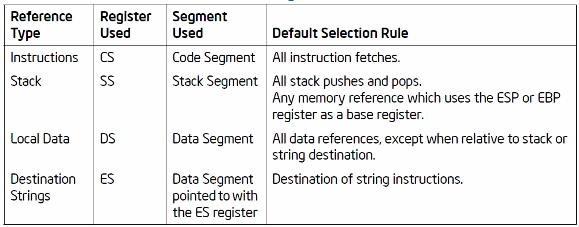
1.6.1 Operand Addressing Modes
Memory Operands Addressing
  Specifying a Segment
    The processor automatically chooses a segment according to the rules given in Table

Slide 51
1.6.1 Operand Addressing Modes
Memory Operands Addressing
  Specifying a Segment
    Segment Override
      When storing data in memory or loading data from memory, the DS segment default can be overridden to allow other segments to be accessed. Within an assembler, the segment override is generally handled with a colon “:” operator.
Example：
MOV AX, [10H] ; Data in DS Segment
MOV AX, ES:[10H] ; Data in ES Segment

Slide 52
1.6.1 Operand Addressing Modes
Memory Operands Addressing
  Specifying a Segment
    Segment Override
      The following default segment selections cannot be overridden:
        Instruction fetches must be made from the code segment.
        Destination strings in string instructions must be stored in the data segment pointed to by the ES register.
        Push and pop operations must always reference the SS segment.

Slide 53
1.6.1 Operand Addressing Modes
Memory Operands Addressing
  Specifying an Offset
    The offset part of a memory address can be specified directly as a static value (called a displacement) or through an address computation made up of one or more of the following components:
      Displacement — An 8-, 16-, or 32-bit value.
      Base — The value in a general-purpose register.
      Index — The value in a general-purpose register.
      Scale factor — A value of 2, 4, or 8 that is multiplied by the index value.(80386 or above)

Slide 54
1.6.1 Operand Addressing Modes
Memory Operands Addressing
  Specifying an Offset
    The offset which results from adding displacement, base, index and scale factor is called an effective address(EA).
EA=Base + ( Index*Scale factor ) + Displacement
components | 16-bit offset | 32-bit offset
displacement | 0,8,16-bit | 0, 8, 32-bit
Base Register | BX, BP | Any 32-bit general purpose registers
Index Register | SI, DI | 32-bit general purpose registers except ESP
Scale factor | Not used | 1, 2, 4, 8

Slide 55
1.6.1 Operand Addressing Modes
Memory Operands Addressing
  Direct Data Addressing
    The EA of the operand in the instruction.
Segment Address
Instruction
Memory
EA
+
Operand
physical address = segment address ×16 + offset
MOV AX, [2000H] ; Direct Addressing
MOV AX, 2000H ; Immediate Addressing

Slide 56
Direct Data Addressing Example1
MOV AX, [1000H]
(DS)=10A0H
+
OP
00H
10H
11A00H 30H
50H
1000H
Physical address
10A0H
10A00H
CODE SEGMENT
1000H
LSB
11A00H
11A00H
DATA SEGMENT
30H
50H
50H
30H
AX
Notes:
主意提醒段地址×16（左移4位）

Slide 57
Direct Data Addressing Example2
MOV BL, ES:[0100H]
(ES)=3000H 30000H
(DS)=2000H + 0100H
30100H 4B
00
BL
0100H
Physical address
3000H
30100H
30100H
4B
4B
In assembly language, you can use symbols address to instead of numerical address, like this:
MOV AX, BUFF
or MOV AX, [BUFF]

Slide 58
1.6.1 Operand Addressing Modes
Memory Operands Addressing
  Register Indirect Addressing
    The EA of the operand in register, register ID in the instruction.
Instruction
register
memory
Base or Index
Register ID
EA
+
operand
Example:
MOV AL, [BX]
MOV AX, CS:[SI]
MOV [BP], AH
MOV ECX, [EDX]
Segment address

Slide 59
MOV AH, [BP]
MOV BX, [SI]
MOV CX, SI
(SS)=1000H, (DS)=2000H , (BP)=0B10H, (SI)=032AH
10000H 20000H
+ 0B10H + 032AH
40H
00H
3EH
46H
1000H
2000H
0B10H
032AH
Physical address
Physical address
10B10H
10B10H
2032AH
2032AH
AH
10B10H
40H
032AH
SI
40H
032AH
10B11H
…
032AH
CX
2032AH
3EH
463EH
BX
2032BH
46

Slide 60
1.6.1 Operand Addressing Modes
Memory Operands Addressing
  Register Relative Addressing
    Base-Plus-Displacement Addressing
      EA = displacement + contents of a base register.
instruction
Segment address
Base Register ID Displacement
memory
EA
+
+
operand
Base Register
Address
Addressing Array Data with Regiser Relative

Slide 61
Example
MOV AX, 3000H[BX] (or [BX+3000H])
MOV AX, COUNT[BX] ; COUNT is Symbol address
（or MOV AX,[COUNT+BX]）
(DS)=3000H， (BX)=2000H，COUNT=4000H
30000H
2000H
+ 4000H
3000H
2000H
4000H
36000H
36000H
34H
36000H 34H
12H
12
1234H
AX

Slide 62
1.6.1 Operand Addressing Modes
Memory Operands Addressing
  Register Relative Addressing
    Index-Plus-Displacement
      EA = displacement + contents of a base register.
instruction
Segment address
Index Register ID Displacement
memory
EA
+
+
operand
Index Register
Address

Slide 63
Example
MOV CX, 6020H[SI] (or [SI+6020H])
MOV DX, COUNT[SI] ; COUNT is Symbol address
（or MOV AX,[COUNT+SI]）
(DS)=3000H， (SI)=2000H，COUNT=1000H
30000H
2000H
+ 1000H
3000H
2000H
1000H
33000H
33000H
33000H 34H
67H
34H
67
6734H
DX

Slide 64
1.6.1 Operand Addressing Modes
Memory Operands Addressing
  Base-Plus-Index Addressing
    EA = contents of a base register + contents of a Index register.
Segment Address
Instruction
Index Register
Base Register ID
Index Register ID
Index
Memory
+
+
Operand
EA
Base
Base Register

Slide 65
Example:
MOV AX, [BX+DI]
MOV AX, [BX][DI]
(DS)=2100H, (BX)=0158H, (DI)=10A5H,
2100H
0158H
21000H
0158H
+ 10A5H
10A5H
Physical address
221FDH
221FDH
34H
221FDH 34H
12H
12
1234H
AX

Slide 66
1.6.1 Operand Addressing Modes
Memory Operands Addressing
  Base Relative-Plus-Index Addressing
    EA = contents of a base register + contents of a Index register + Displacement.
Instruction
Base Register ID
Index Register ID
Displacement
memory
EA
Index
+
+
Operand
Index Register
Base
Segment Address
Base Register

Slide 67
Example:
MOV AX, MASK[BX+SI]; COUNT is Symbol address
(DS)=3000H, (BX)=2000H, (SI)=1000H, MASK=0250H
30000H
2000H
1000H
+ 0250H
33250H 20H
43H
3000H
2000H
1000H
0250H
Physical address
33250H
33250H
20H
43
4320H
AX

Slide 68
1.6.1 Operand Addressing Modes
I/O Port Addressing
  I/O Port Direct Addressing
    An 8-bit I/O port address(Address between 00 and 0FFH) must be addressed with an immediate operand.
      IN AL, 20H ; input a byte from port 20h to AL
      OUT 63H, AL ; output a byte from AL to port 63h
  I/O Port Indirect Addressing
    A 16-bit I/O port address(Address above 0FFH) must be addressed with a value in the DX register.
      MOV DX,3F8H
      IN AL, DX ; input a byte from port 3f8h to AL

Slide 69
1.6.2 Programming Memory Addressing Modes
Programming Memory Addressing modes used with the JMP and CALL instructions
Consist of three distinct forms:
  Direct Programming Memory Addressing
  Relative Programming Memory Addressing
  Indirect Programming Memory Addressing

Slide 70
1.6.2 Programming Memory Addressing Modes
Direct Programming Memory Addressing Modes
  The instructions for direct programming memory addressing store the address with the opcode.
  The direct jump is often call a far jump because it can jump any memory location for the next instruction.
  In the real mode, a far jump accesses any location within the first 1M byte of memory by change both CS and IP.
Example:
JMP FAR PTR NEXT_PRO

Slide 71
1.6.2 Programming Memory Addressing Modes
Relative Programming Memory Addressing Modes
  The term relative means “relative to IP”
  The JMP instruction is a one-byte instruction, with a one-byte or a two-byte displacement that add to the IP. Both types can jump anywhere within the current code segment
    A one-byte displacement is used in short jump
    A two-byte displacement is used in near jump or call
  Relative JMP and CALL instructions contain either an 8-bit or a16-bit signed displacement that allows a forward memory reference or a reverse memory reference.

Slide 72
1.6.2 Programming Memory Addressing Modes
Relative Programming Memory Addressing Modes
  All assemblers automatically calculate the distance for the displacement and select the proper one- or two-byte form.
    An 8-bit displacement has a jump range of between +127 and -128 bytes from the next instruction; a 16-bit displacement has a range of ± 32K bytes.
offset | Machine code | program
0000 | 0405 | ST: ADD AL,05H
0002 | 90 | NOP
0003 | EBFB | JMP SHORT ST
0005 | 90 | NOP

Slide 73
1.6.2 Programming Memory Addressing Modes
Indirect Programming Memory Addressing Modes
  Near Indirect
    Near indirect jump instruction can use any 16-bit register; any relative register; and any relative register with a displacement to be the address of next instruction.
If (DS)=2000H，(BX) =1000H，EA _{TABLE}=1000H，( 21000H) =0040H，(22000H)=5678H，then after execute:
JMP BX ；IP=1000H
JMP [BX] ；IP=0040H
JMP TABLE[BX] ；IP=5678H

Slide 74
1.6.2 Programming Memory Addressing Modes
Indirect Programming Memory Addressing Modes
  Far Indirect
    Far indirect jump instruction can use any relative register; and any relative register with a displacement to be the address of next instruction.
If (DS)=2500H，(SI)=1300H，(26300H)=4500H，(26302H)=32F0H, the after execute：
JMP DWORD PTR [SI]；CS=32F0H，IP=4500H

Slide 75
1.6.3 Stack Memory Addressing Modes
What is stack?
  Stack holds data temporarily stores the return address used by procedures.
  The stack memory is a LIFO(last-in, first-out) memory.
Stack memory addressing Modes
  It is contained in a segment and identified by the segment selector in the SS register.
  The SP register always point to an area of memory located within the stack segment.
  Items are placed on the stack using the PUSH instruction and removed from the stack using the POP instruction.

Slide 76
1.6.3 Stack Memory Addressing Modes
PUSH operation
  Whenever a word of data is pushed onto the stack, the high-order 8 bit are placed in the location addressed by SP-1; The low-order 8 bit are placed in the location addressed by SP-2.
  The SP is then decremented by 2 so that the next word of data is stored in the next available stack memory location.
POP operation
  Whenever a word of data is popped from the stack, the low-order 8 bit are removed from the location addressed by SP. The high-order 8 bit are removed from the location addressed by SP+1.
  The SP is then incremented by 2.

Slide 77
1.6.3 Stack Memory Addressing Modes
Note
  The PUSH and POP store or retrieve words of data -never byte- in the 8086 through the 80286 microprocessor. 80386 and above allow words or doublewords.
  Data may be popped off the stack into any register or any segment register except CS.
  The SP register add to SS×10H to form the stack memory address in the real mode.
Example:
PUSH AX
POP DS

